Slide 1
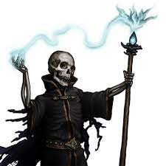
The Night of the Lich
Pitch Date: 12/18/2022 Update 3/5/2023
Release Date: 4/9/2023 186 Commits (+6)
Team Lead: Vince McKeown 11 Contributors
1
2
3
4
5
6
7
8
9
10
11
12
13
14
15
16

Slide 2
Vince McKeown
Coded random leafs
Added side views for the Lich

Slide 3
H Trayford
Populated the Graveyard scene

Slide 4
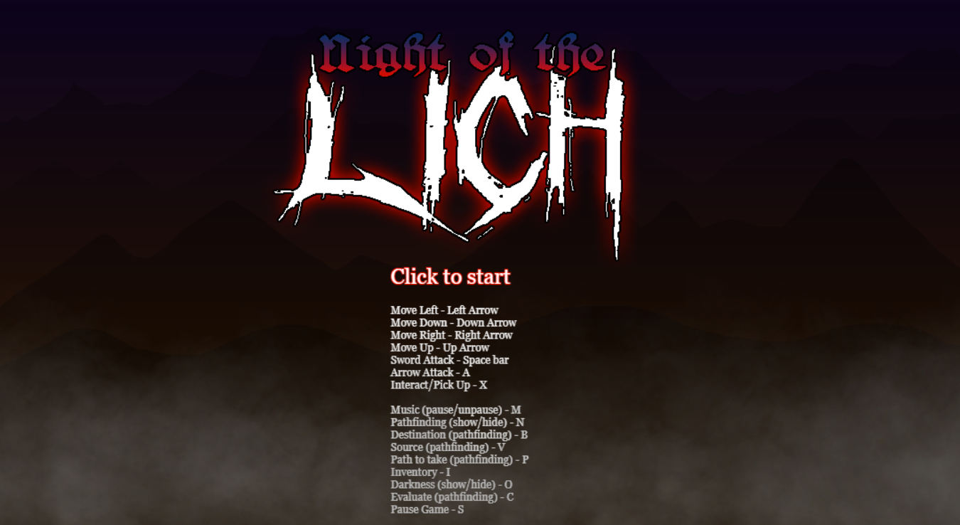
Christer “McFunkyPants” Kaitila
Cover Art and Main Menu

